Slide 1


Digital Portfolio of Aiswarya E
This presentation highlights the digital portfolio of Aiswarya E, a B.Sc. Computer Science student at Mahalashmi Women's College of Arts and Science. It showcases her projects and skills in a clear and structured format, illustrating her capabilities and achievements in the field of computer science.

Slide 2

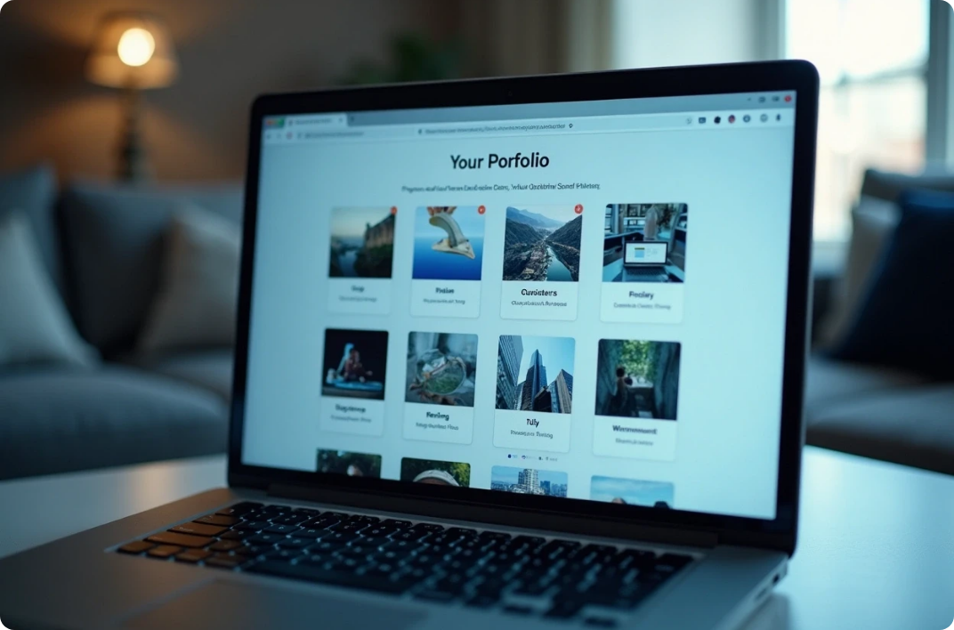

Creating a Digital Portfolio
Identifying the Need
Showcasing Achievements
Enhancing Job Search
Recognizing the importance of a digital portfolio in showcasing work.
Effectively presenting academic and project-related work to potential employers.
Addressing the challenge of demonstrating skills visually and organized.

Slide 3



Project Overview
Sections Included
2
Features introduction, project summaries, and skills inventory.
Digital Portfolio
1
Compiles various academic projects and personal achievements.
Complete Candidate Picture
3
Presents a comprehensive profile including contact information.

Slide 4

End Users of Portfolios
Academic Institutions
Students
Universities may use portfolios to assess students' readiness for advanced studies or internships.
Peers can also benefit by understanding how to structure their own portfolios effectively.

Slide 5




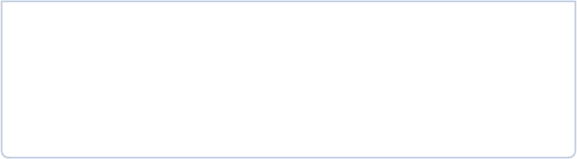

Tools and Technologies
1
2
Web Development Tools
Version Control Systems
Utilization of HTML, CSS, and JavaScript to create an interactive online portfolio.
Git or GitHub for managing changes in the project, showcasing technical proficiencies.

Slide 6






Portfolio Design and Layout
The portfolio is designed to emphasize a clean and modern aesthetic, prioritizing readability and visual appeal. Logical organization with clear headings and sections enhances the overall user experience. Additionally, responsive design principles guarantee accessibility across various devices including smartphones, tablets, and desktops.
2
Device Responsiveness
Accessible on smartphones, tablets, and desktops.
Modern Layout
Prioritizes readability and visual appeal.
1
User Experience
Logical organization enhances navigation.
3

Slide 7



Features and Functionality
Project Showcase
Interactive Elements
Each project has a dedicated section with descriptions, objectives, technologies used, and outcomes.
Features like hover effects, clickable prototypes, and embedded links make the portfolio engaging.

Slide 8

Results and Screenshots
The initial user testing phase shows positive feedback on the design and usability of the portfolio, with users finding it easy to navigate. Screenshots capture various sections of the portfolio, highlighting the project display, layout, and interactivity features.
User Feedback
Screenshots Overview
Project Display
Positive responses regarding design and navigation.
Visuals highlighting different sections of the portfolio.
Highlighted sections showcasing various projects.

Slide 9
Conclusion of the Digital Portfolio
2
Modern Design
Utilizes modern design and technology for academic needs.
Powerful Tool
Students can effectively present their educational journey.
1
Career Preparation
Prepares students for future career opportunities.
3

